Slide 1
US Immigrants Green Card Analysis
File created on: 14/01/23 8:23:09 pm GMT-5

Slide 2
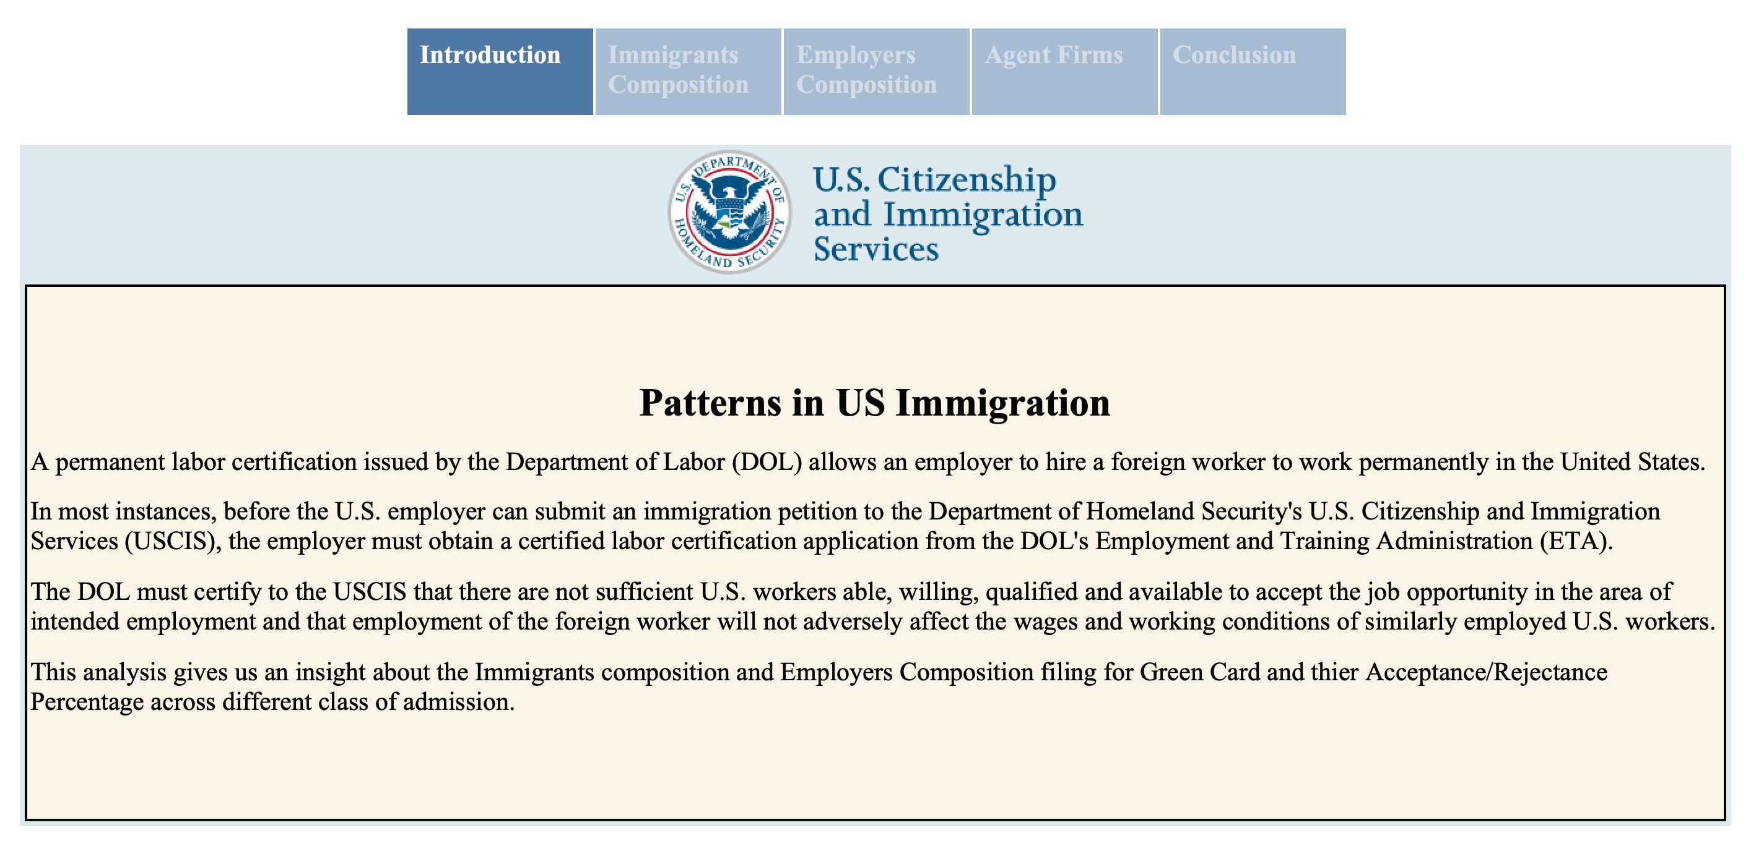

Slide 3
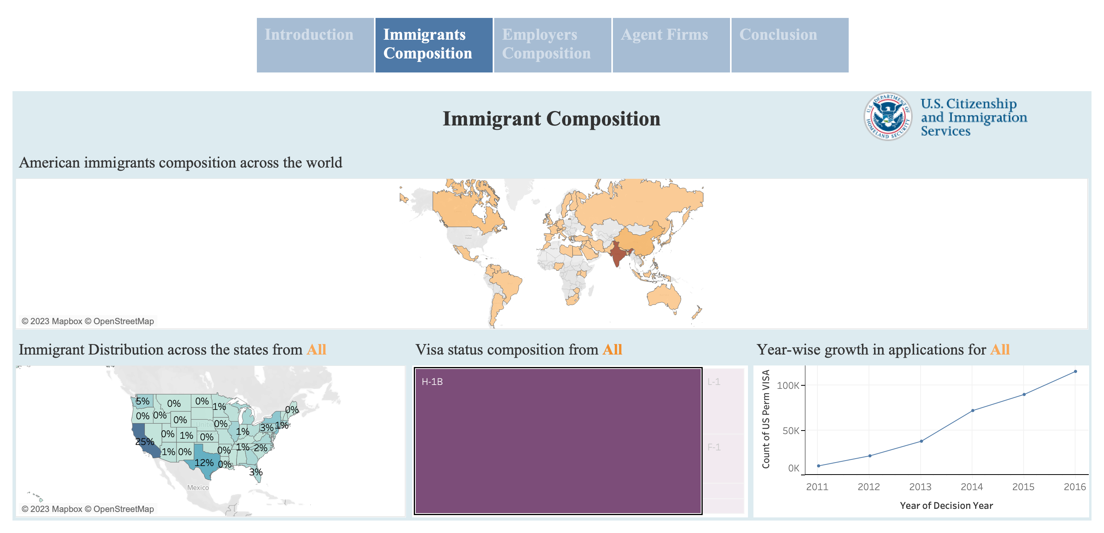

Slide 4
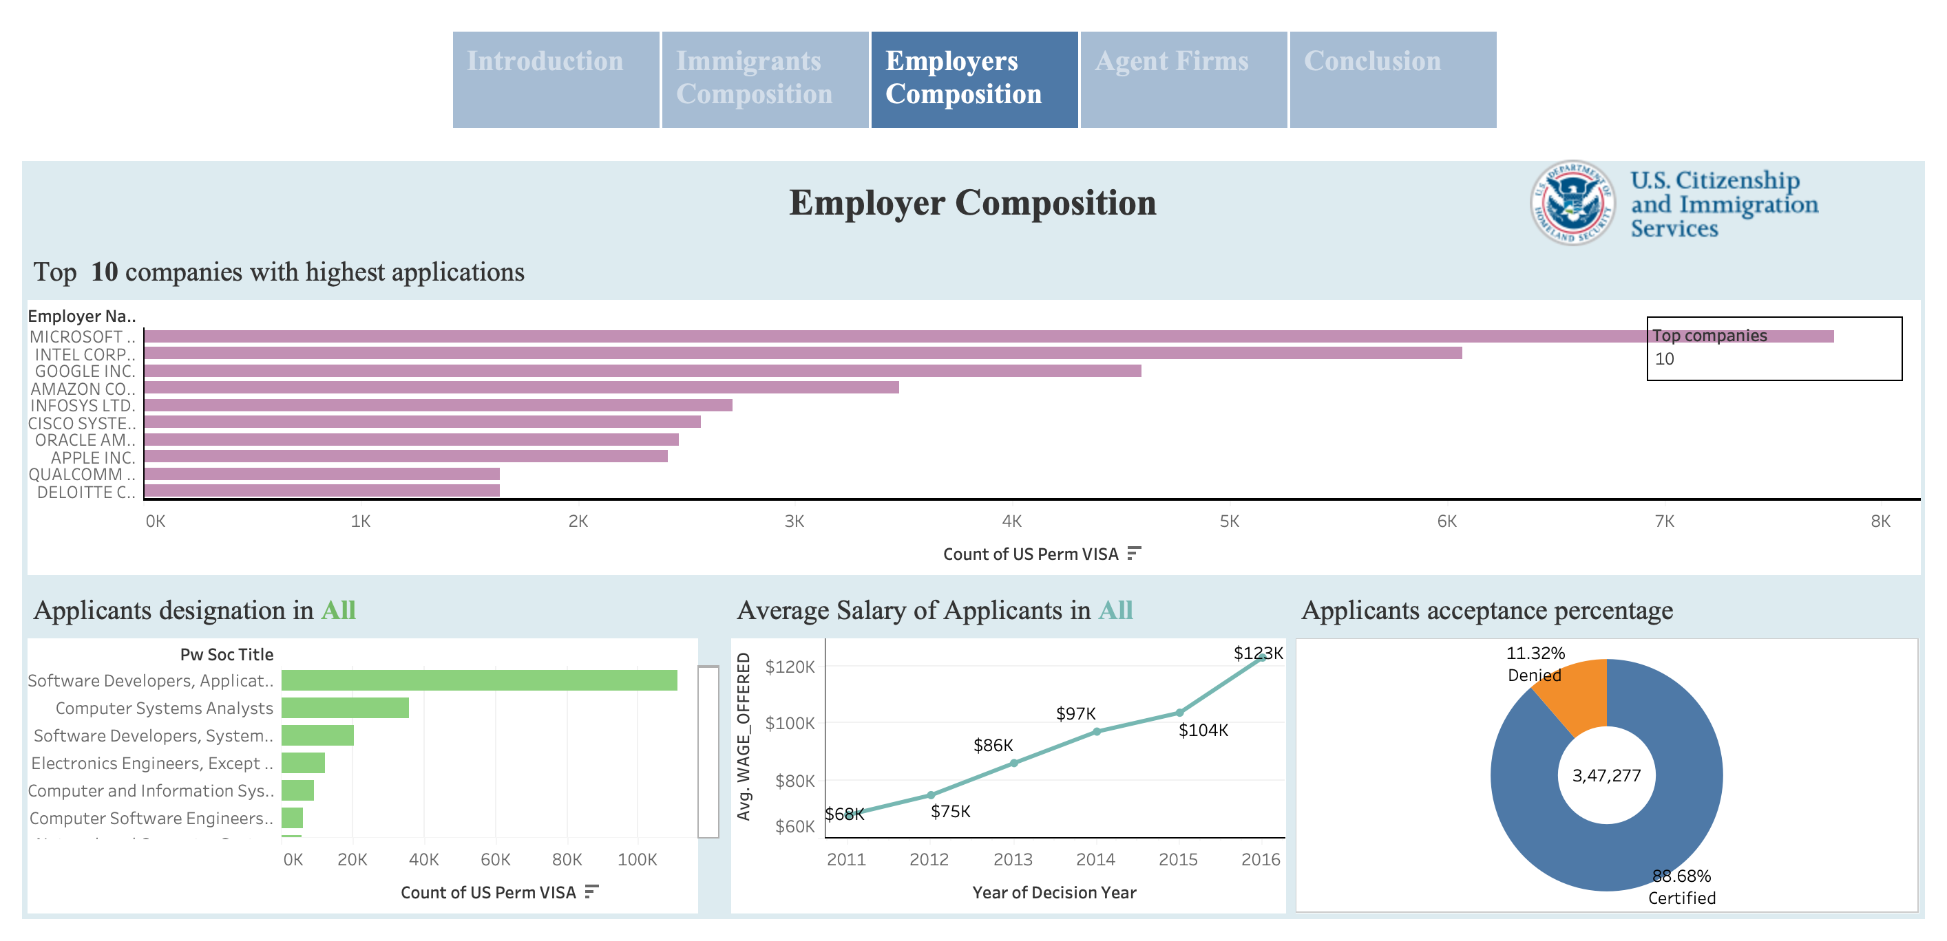

Slide 5
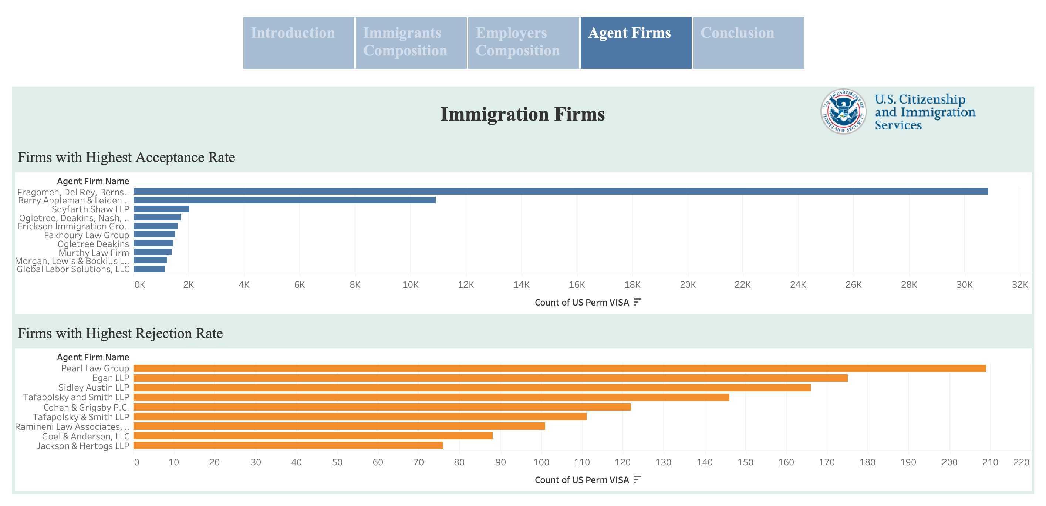

Slide 6
